Slide 1
Actin Nucleation and Elongation
Ram Balak Mahto
Guest faculty
Department of Zoology
V.S.J College Rajnagar Madhubani Class B.sc 2nd ,Paper 3 , 7908055676

Slide 2
Introduction
Many cellular processes powered by actin polymerization (e.g. cell motility, endocytosis, and cytokinesis) depend on responsive, rapid bursts of actin filament assembly at specific subcellular locations.
Cells typically contain a large pool of actin monomers that is buffered by actin monomer-binding proteins such as thymosin β4 and profilin. These factors suppress spontaneous nucleation of new filaments, yet enable rapid mobilization of monomers for elongation at existing filament ends. This makes nucleation the rate-limiting step in de novo filament formation.

Slide 3
Continue…
Once nucleated, filaments elongate at their fast-growing (barbed) ends at a rate linearly proportional to the concentration of available actin monomers.
Elongation at the slower-growing (pointed) ends of filaments may not be physiologically relevant since most actin monomers are bound to proteins that block addition to pointed ends. T
he extent of filament elongation in vivo is severely limited by the presence of high affinity barbed end capping proteins

Slide 4
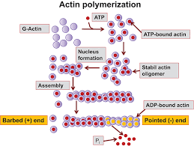
Barbed and pointed end of actin filament

Slide 5
Actin Nucleation
Nucleation is the rate-limiting step in de novo filament formation.
The extent of filament elongation in vivo is severely limited by the presence of high affinity barbed end capping proteins.
To overcome these barriers to filament nucleation and elongation, cells express many actin assembly promoting factors (nucleator).

Slide 6
Actin Nucleators properties
A nucleator can be defined as a factor that stimulates formation of a filament that grows rapidly at its barbed end.
Nucleator should be able to efficiently seed polymerization from a pool of profilin-bound actin.
monomers (profilin-actin), since this may be the dominant species of available ATP-actin monomers in eukaryotic cells.

Slide 7
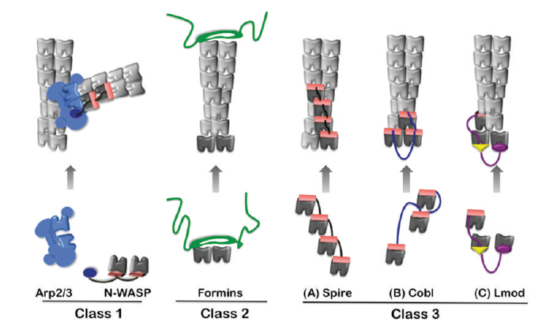
Different class of nucleator

Slide 8
class׀ nucleator
The first nucleator identified, Arp2/3 complex, combined with a ‘nucleation promoting factor’ (NPF), Arp2/3 complex catalyzes polymerization of a new (daughter) filament from the side of an existing (mother) filament at a 70° angle to generate a branched structure.
The most well understood Arp2/3 complex NPFs are WASp/SCAR/WAVE
family proteins, which perform at least two essential roles in nucleation.
First, they trigger conformational changes in Arp2/3 complex that bring its actin-related protein subunits (Arp2 and Arp3) into close register, possibly to mimic an actin dimer.
Second, they recruit 1-2 actin monomers, which is a critical step in nucleation since Arp2/3 complex alone binds very weakly to monomers.

Slide 9
class׀׀ nucleator
The second group of nucleators identified, formins, catalyze the formation of linear(unbranched) actin filaments in vitro and assemble diverse actin structures, including stress fibers, cytokinetic actin rings, and actin cables in vivo .
The mechanism of actin assembly by formins involves high affinity binding of their dimeric donut-shaped FH2 domains to the barbed ends of actin filaments.
In contrast to Arp2/3 complex, which remains associated with the pointed end of the filament it nucleates, the formin FH2 domain remains associated with the barbed end. After nucleation, the FH2 moves processively with the growing barbed end, allowing rapid insertion of new actin subunits.

Slide 10
Recently identified Nucleator
The more recently identified nucleators Spire, Cordon bleu (Cobl), and Leiomodin (Lmod) employ yet a third nucleation mechanism that involves actin monomer recruitment to form polymerization seeds.

Slide 11
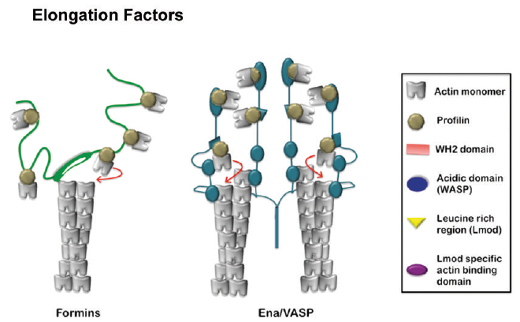
Actin Elongation Factors

Slide 12
Actin filament Elongation
Actin elongation factors. Formins shield barbed end growth from capping proteins by using their dimeric FH2 domains to processively move with the filament end.
Adjacent rope-like FH1 domains are used as “arms” to recruit profilin-actin complexes and ‘deliver’ them to the FH2-capped filament end for rapid addition.
The elongation mechanism of Ena/VASP is not well understood. However, it tetramerizes, bundles filaments, and may engage multiple barbed ends simultaneously.
Its ability to accelerate barbed end elongation could involve a relay or hand-off of actin monomers using multiple actin-binding domains

Slide 13
Thank u

